Slide 1
Canvas Academic Insights: A Grade Retrieval, Visualization, and AI Analysis Toolkit
Data 533: Collaborative Software Development
Richard Hua, Jordan Kaseram, Yue Wang

Slide 2
Introduction
We are aiming to create a Command Line Interface App. Examples Include
spotify-tui
cowsay
btop
This library will ask for a canvas token, and a local ollama llm model needs to be installed:
Pull all assignment grades from canvas for every class you have that you can still view
Perform some basic visualization of grades
If ollama llm is set up properly, provide AI generated analysis of grades

Slide 3
Sub-Package 1 Module 1
Main state machine module of the package
Functions:
Function to prompt user for canvas url/token
Function to prompt user for courseids to skip because of canvasapi restrictions
Function to call module 2 to retrieve canvas grades
Function to call sub-package 2 to get visualizations
Function to call sub-package 3 to get ai suggestions

Slide 4
Sub-Package 1 Module 2
Module that handles retrieving information from Canvas
Functions:
Function to use Canvas token to retrieve grade data
Function to parse data to a data structure
Function to clean data structure
Grade class object
AssignmentGrade child object
QuizGrade Child object
FinalGrade Child object

Slide 5
Sub-Package 2 Module 1
Module that generates general summary charts
Functions:
Function to create bar chart showing average grade per course.
Function to create a histogram showing distribution of assignment percentages
Function to create pie chart of missing vs completed assignments
Function to plot number as assessments (assignments and quizzes) per course

Slide 6
Sub-Package 2 Module 2
Module that visualizes the data involving dates or time-based analysis to
show how grades change over time
Functions:
Function to plot assessment percentages over time
Function to retrieve the last quiz and assignment graded
Function to to plot the last graded assessment
Function to plot a heatmap showing weekly score average

Slide 7
Sub-Package 3 Module 1
This subpackage is an openAI integration. This subpackage will deliver grade data
to openAI and have openAI act as a “coach”
Functions:
Function to ask AI about summarize performance over time
Function to ask AI about strongest and weakest courses
Function to ask AI about a study plan

Slide 8
Sub-Package 3 Module 2
This subpackage is an openAI integration. This subpackage will have openAI
summarize upcoming deliverables
Functions:
Function to ask AI to summarize due dates
Function to ask AI to recommend study schedule / work schedule based on deliverable due date
Function to ask AI to summarize latest announcements

Slide 9
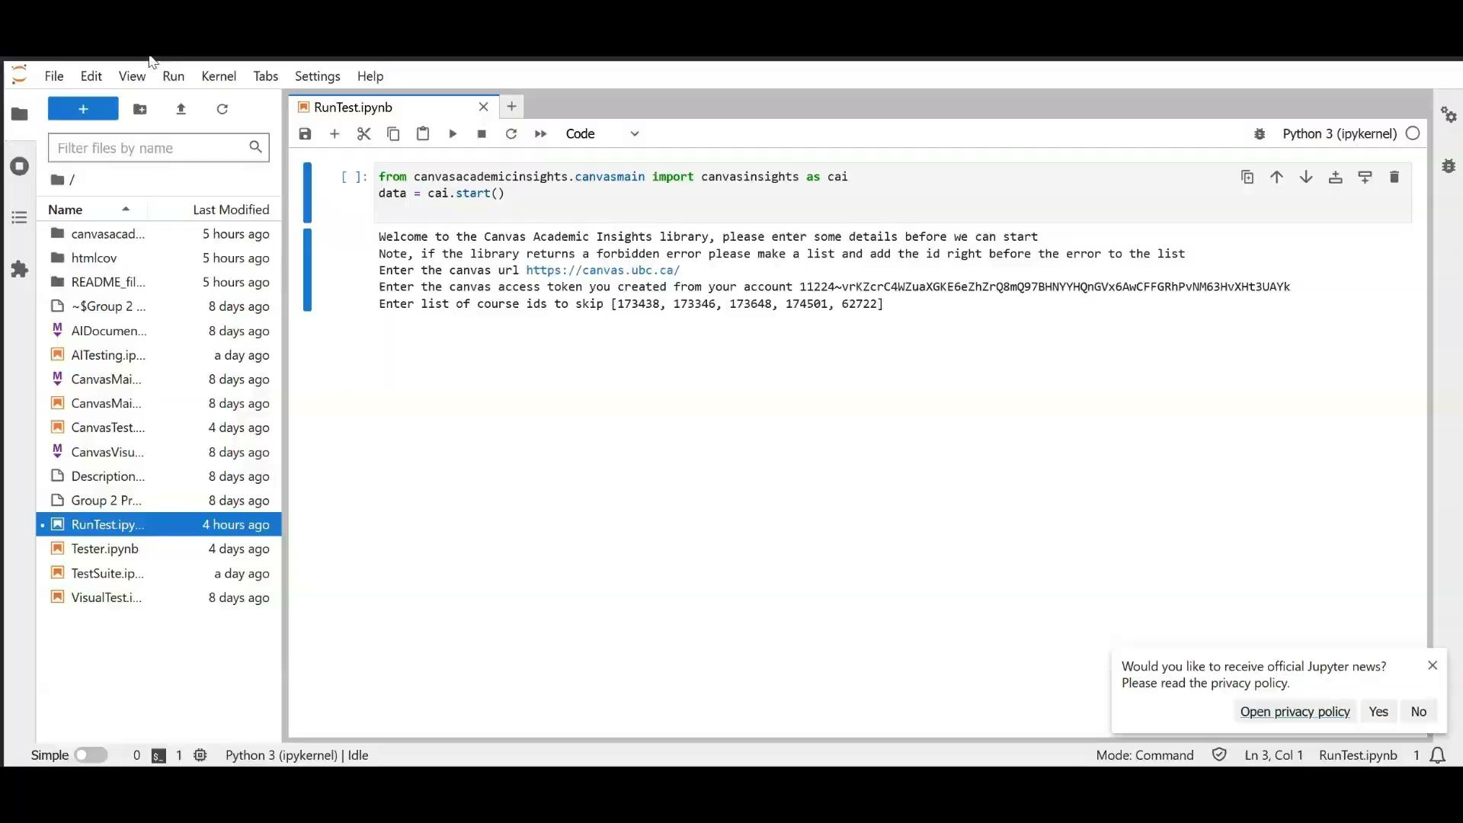
Demo

Slide 10
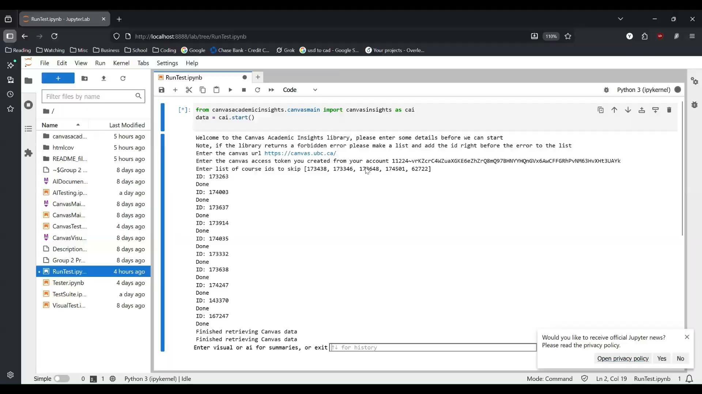
Demo

Slide 11
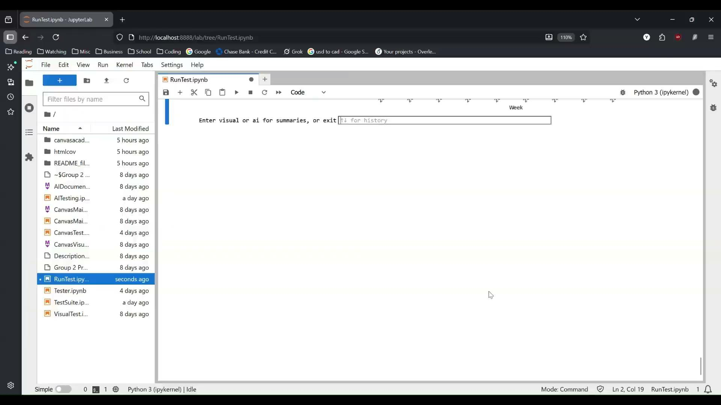
Demo

